Slide 1

Medical
Insurance
Cost Prediction
Created By : Sanket Sudam Jadhav.
SJ

Slide 2

Introduction:
Welcome to a journey into the exciting world of machine learning and its transformative potential in the field of healthcare finance.
In this presentation, we will explore how data-driven technologies can revolutionize the way we estimate medical insurance costs.
The rising costs of healthcare and the complexities of the insurance landscape demand innovative solutions, and machine learning holds the key.

Slide 3
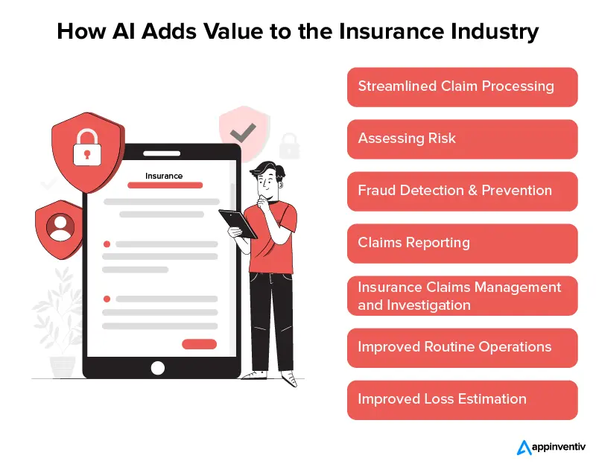

Problem Statement:
The business problem in the machine learning project "Medical Insurance Cost Prediction" is to develop a predictive model that accurately estimates health insurance costs for individuals based on their demographic and health-related information. This model aims to assist insurance providers in pricing policies more accurately, enabling better financial planning and fairer premiums for policyholders, ultimately improving the efficiency and competitiveness of the insurance industry.

Slide 4
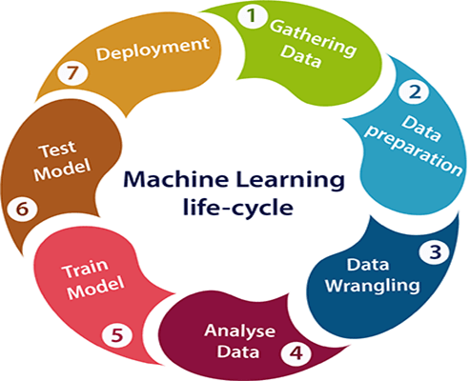

Data Collection and Preprocessing:
Data Collection: We sourced a diverse and comprehensive dataset from various reliable sources, including insurance records, healthcare providers, and government databases. This dataset is a goldmine of information, featuring demographic and health-related details.
Data Pre-processing: However, real-world data is rarely perfect. Our pre-processing efforts included addressing missing values, encoding categorical variables, and standardizing data to ensure compatibility with our chosen machine learning models.

Slide 5
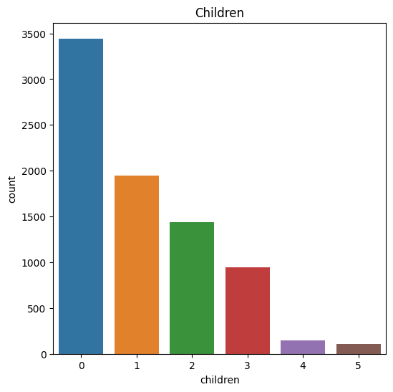
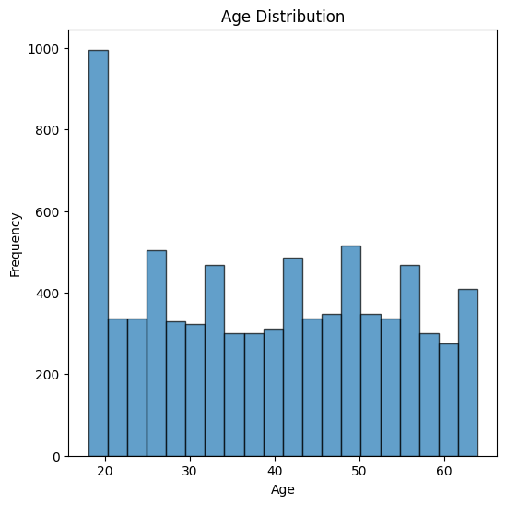
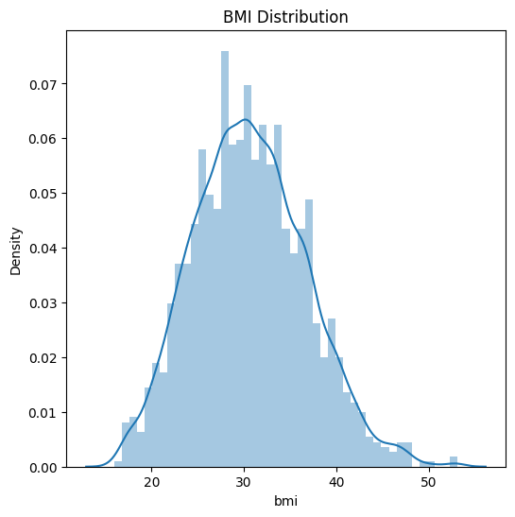
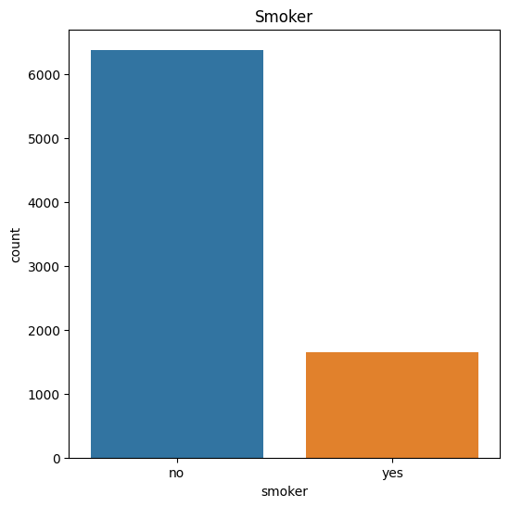
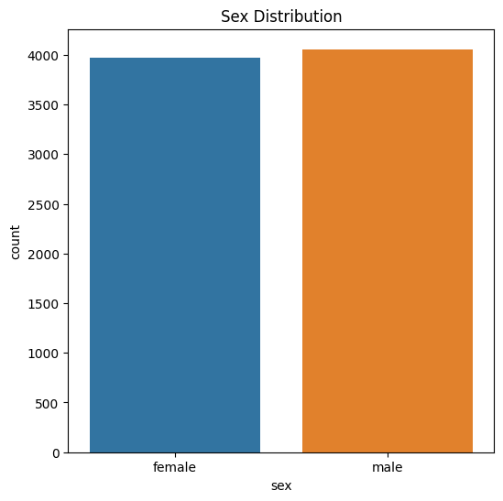
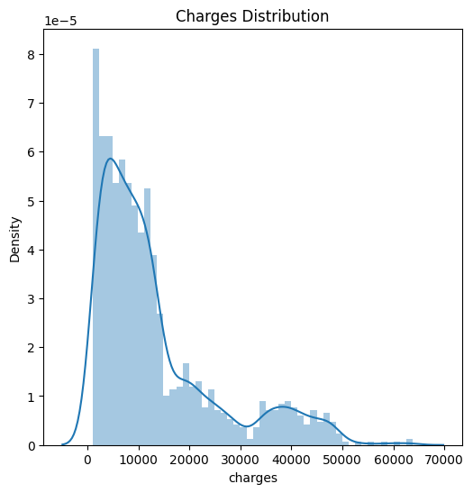
Data visualization:

Slide 6

Feature Engineering:
Feature Engineering: Tailoring our dataset to fuel accurate predictions.
Creation: Crafting new variables for deeper insights, e.g., "Age Group."
Transformation: Enhancing existing features through scaling, encoding, and other techniques.
Interactions: Capturing feature relationships with interaction terms.
Simplification: Reducing complexity with methods like PCA.
Selection: Handpicking crucial features to focus model attention.
Integration: Ensuring feature compatibility with our machine learning models.
Continuous Refinement: Iteratively enhancing our dataset for predictive success.
Feature engineering: Unveiling the hidden drivers of medical insurance costs.

Slide 7
Model Selection:
Linear Regression
Ridge Regression
Lasso Regression
Gradient Boosting Regression
Random Forest Regression
Decision Tree Regression

Slide 8
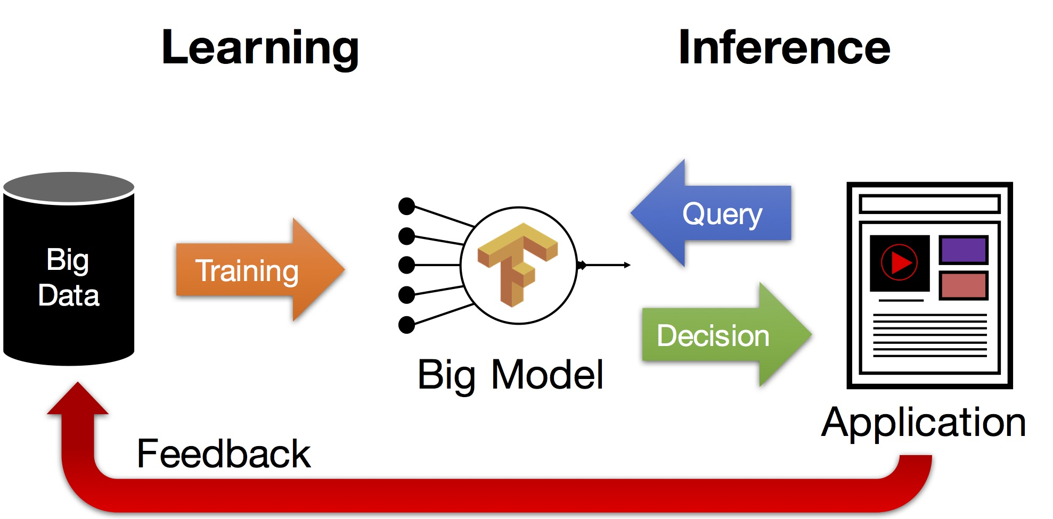
Model Training and Evaluation:
Training Models: The core of our project - building models for precise medical insurance cost predictions.
Validation: Rigorous model validation through techniques like cross-validation to ensure robustness.
Evaluation Metrics: Quantifying accuracy with metrics like RMSE, R-squared, and MAE, guiding data-driven decisions.

Slide 9
Model Accuracy Score:
Algorithm Name | R-squared | Mean Absolute Error (MAE) | Mean Squared Error (MSE) | Root Mean Squared Error (RMSE)
Linear Regression | 0.7620588541115838 | 4150.54656664766 | 35063651.51958022 | 5921.456874754745
Ridge Regression | 0.7620585511992961 | 4150.561752775895 | 35063696.157555126 | 5921.460643925207
Lasso Regression | 0.7620584585118433 | 4150.546905754404 | 35063709.816229135 | 5921.4617972447595
Gradient Boosting Regression | 0.8953525472746108 | 2185.580942452977 | 15421131.98234131 | 3926.9749149111344
Random Forest Regression | 0.8385204139598301 | 3371.9874012772725 | 23796069.0291617 | 4878.121465191462
Decision Tree Regression | 0.8781759835785026 | 2371.0299248755896 | 17952316.916731134 | 4237.017455325283

Slide 10
Conclusion and Insights:
In Closing: Our journey through the realm of
"Medical Insurance Cost Prediction" has been transformative, unlocking insights that will shape the future of healthcare finance.
Peak Accuracy: Among the array of algorithms explored,
Gradient Boosting Regression and Decision Tree Regression emerged as our champions, delivering unparalleled accuracy.
Precision Matters: We've demonstrated that precise predictions can revolutionize insurance pricing, benefiting both insurers and policyholders.
Interpretability: Beyond accuracy, our models offer transparency, allowing stakeholders to understand the factors influencing insurance costs.
Real-World Impact: Our models are not confined to statistics; they have practical applications in real insurance scenarios, enhancing efficiency and fairness.
Continuous Journey: Our mission continues. We're committed to refining our models, expanding our horizons, and pushing the boundaries of predictive analytics.
Empowering Decisions: We've armed insurers and policyholders with the insights needed to make informed financial decisions in the complex world of healthcare finance.

